Slide 1
Electric Moter Temperature Prediction Using Machine Learning
SlideMake.com

Slide 2

Introduction to Electric Motor Temperature Prediction
Electric motor temperature prediction is essential for preventing overheating and ensuring operational efficiency.
Machine learning techniques offer advanced capabilities for accurate temperature forecasting.
This presentation explores how machine learning can be applied to predict electric motor temperatures effectively.
Notes:
Image source: https://opengraph.githubassets.com

Slide 3
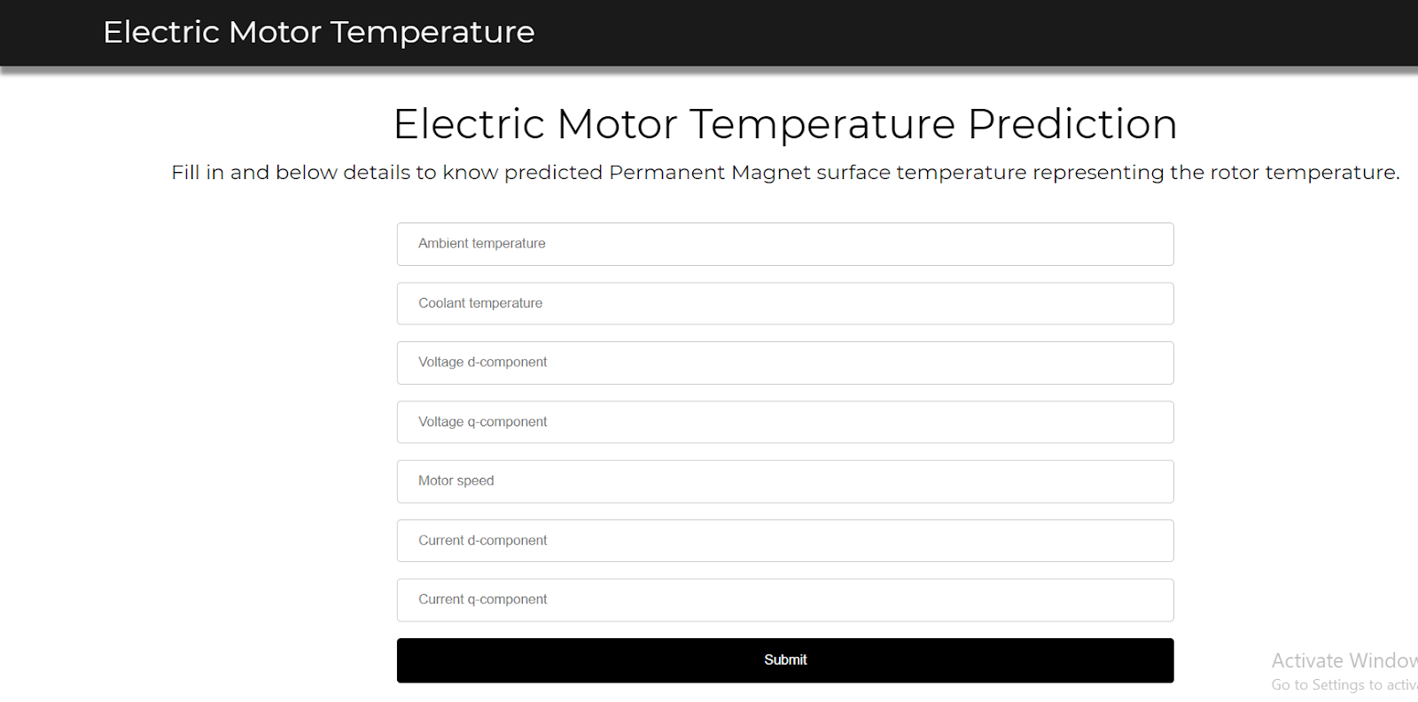
Importance of Temperature Monitoring in Electric Motors
Monitoring temperature helps avoid damage and extends the lifespan of electric motors.
Overheating can lead to failures, costly repairs, and safety hazards.
Accurate prediction models enable proactive maintenance and operational adjustments.
Notes:
Image source: https://user-images.githubusercontent.com

Slide 4
Key Factors Influencing Motor Temperature
Current, voltage, and load conditions significantly impact motor temperature.
Environmental factors like ambient temperature and cooling efficiency also play a role.
Internal factors such as motor design and insulation quality affect heat generation and dissipation.
Notes:
Image source: https://opengraph.githubassets.com

Slide 5
Data Collection for Machine Learning Models
Data includes sensor readings of temperature, current, voltage, and environmental conditions.
Proper data preprocessing is crucial for model accuracy, including cleaning and normalization.
Collecting high-quality, labeled data is essential for training effective machine learning models.
Notes:
Image source: https://www.researchgate.net

Slide 6
Machine Learning Algorithms for Prediction
Common algorithms include decision trees, support vector machines, and neural networks.
Regression models are often used to predict continuous temperature values.
The choice of algorithm depends on data complexity, size, and desired prediction accuracy.
Notes:
Image source: https://www.researchgate.net

Slide 7
Model Training and Validation
Data is split into training and testing sets to evaluate model performance.
Cross-validation helps ensure the model generalizes well to unseen data.
Performance metrics like RMSE, MAE, and R-squared assess the accuracy of temperature predictions.
Notes:
Image source: https://www.researchgate.net

Slide 8
Deployment and Real-time Prediction
Trained models can be integrated into monitoring systems for real-time temperature prediction.
Continuous data streaming allows for dynamic updates and alerts for potential overheating.
Proper system integration ensures reliable and timely maintenance decisions.
Notes:
Image source: https://www.researchgate.net

Slide 9

Challenges and Limitations
Limited or poor-quality data can hinder model accuracy.
Model interpretability may be complex, especially with deep learning approaches.
External factors and unexpected conditions can still cause prediction errors.
Notes:
Image source: https://opengraph.githubassets.com

Slide 10
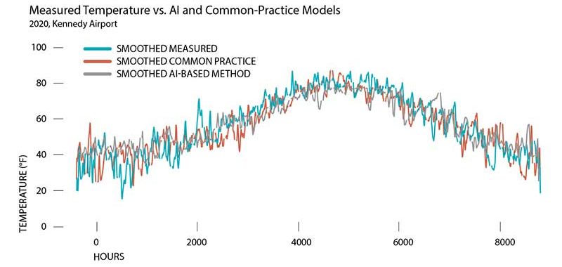
Future Trends and Developments
Advances in IoT and sensor technology will enhance data collection and model accuracy.
Hybrid models combining physics-based and data-driven approaches are emerging.
AI-driven predictive maintenance will become more accessible and cost-effective for industries.
Notes:
Image source: https://corporateresponsibility.thorntontomasetti.com

Slide 11
Conclusion and Takeaways
Machine learning provides powerful tools for accurate electric motor temperature prediction.
Proper data collection, model selection, and deployment are critical for success.
Ongoing research and technological advancements will further improve predictive capabilities in this field.
Notes:
Image source: https://www.researchgate.net

